Slide 1

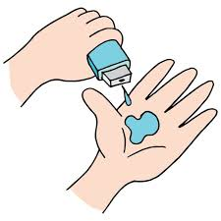
Techno Minds
NIDAN
Kunal Thakkar
Pranav Singh
Vedant Tadla

Slide 2

NIDAN
PROJECT TITLE
We Believe in Scientific Data

Slide 3

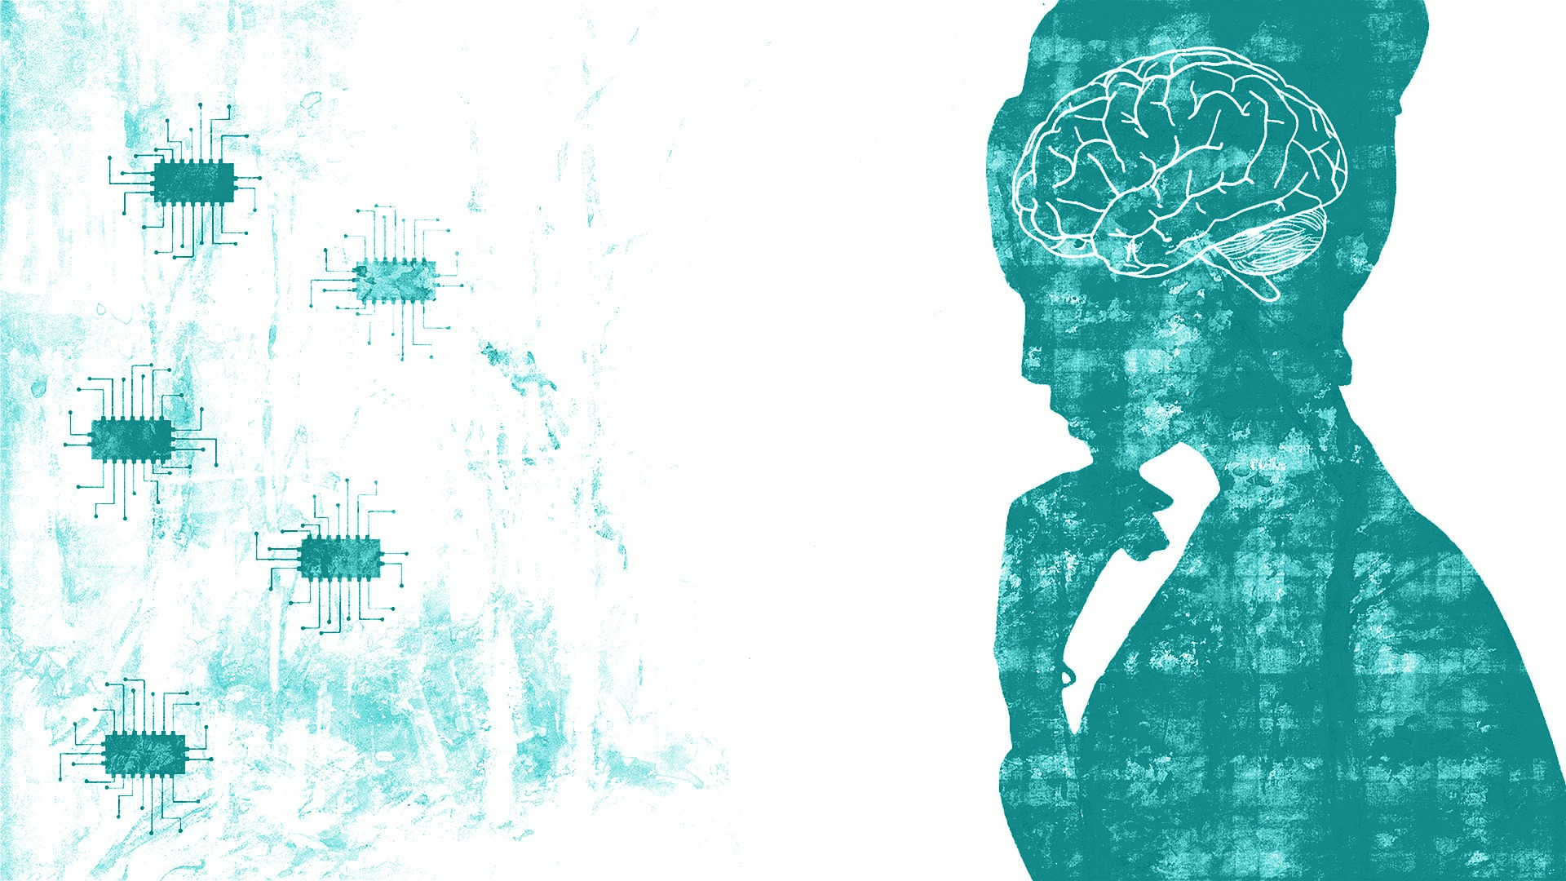

AGENDA
Building a Robust ML model to predict chronic disease and mental health condition of the user
Building a User interactive interface for predictions
Making predictions on the basis of scientific data

Slide 4


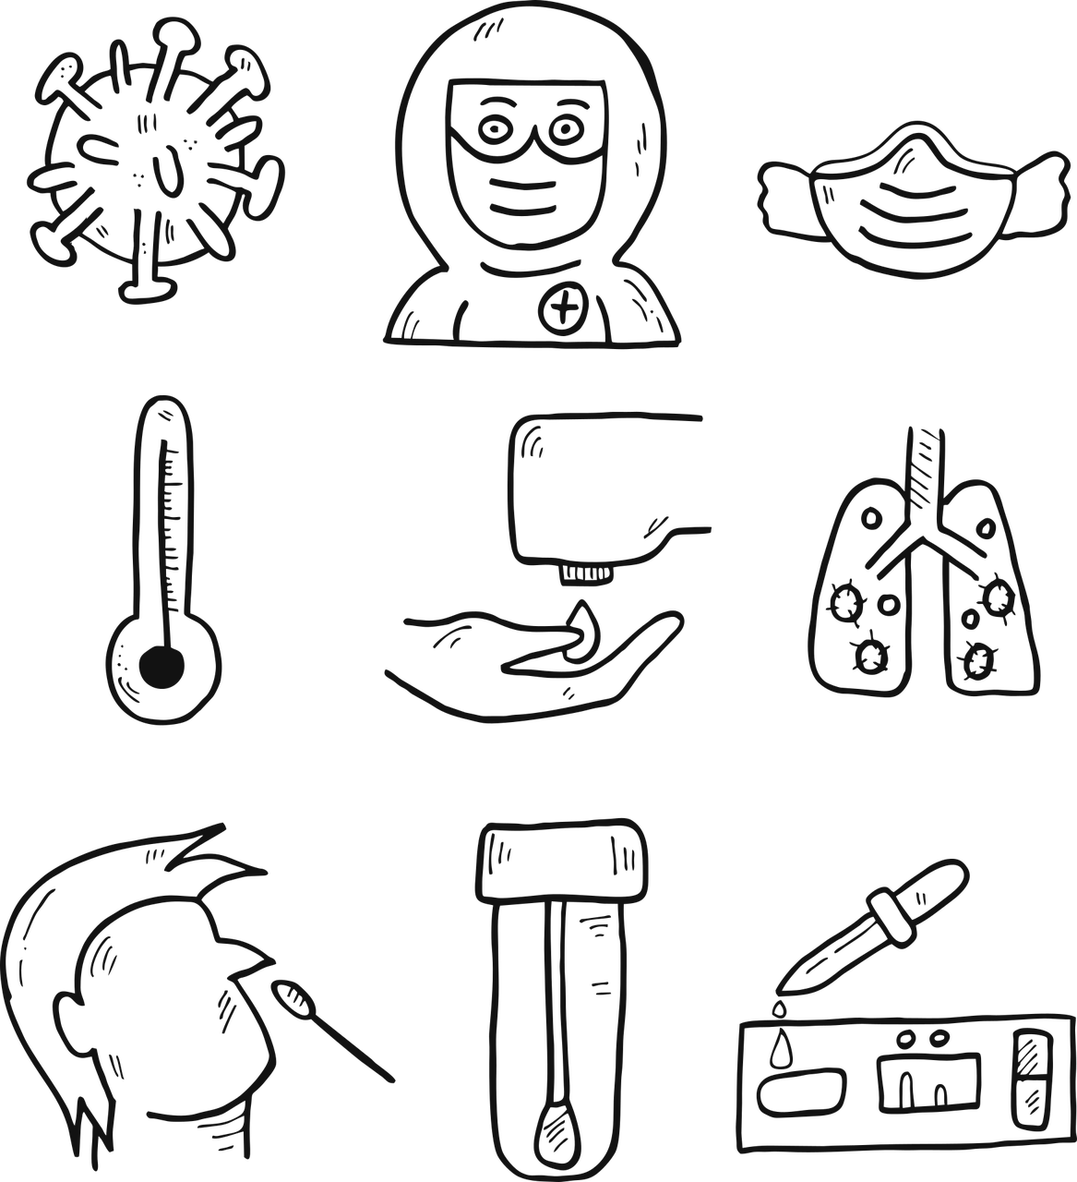
PROBLEM STATEMENT
Predicting Chronic Disease and Mental Health of the user

Slide 5

PROJECT OVERVIEW
This Project Consist of:-
ML & DL Models
EDA(Exploratory Data Analysis)
User Friendly Front End Development

Slide 6
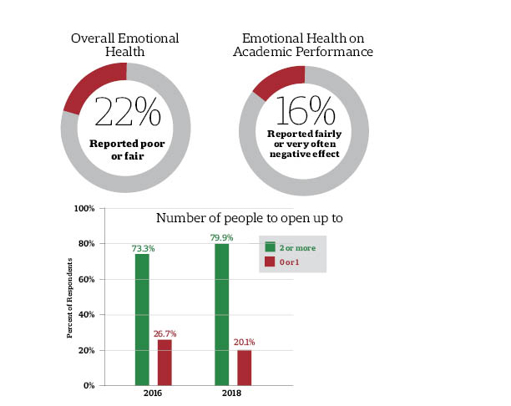
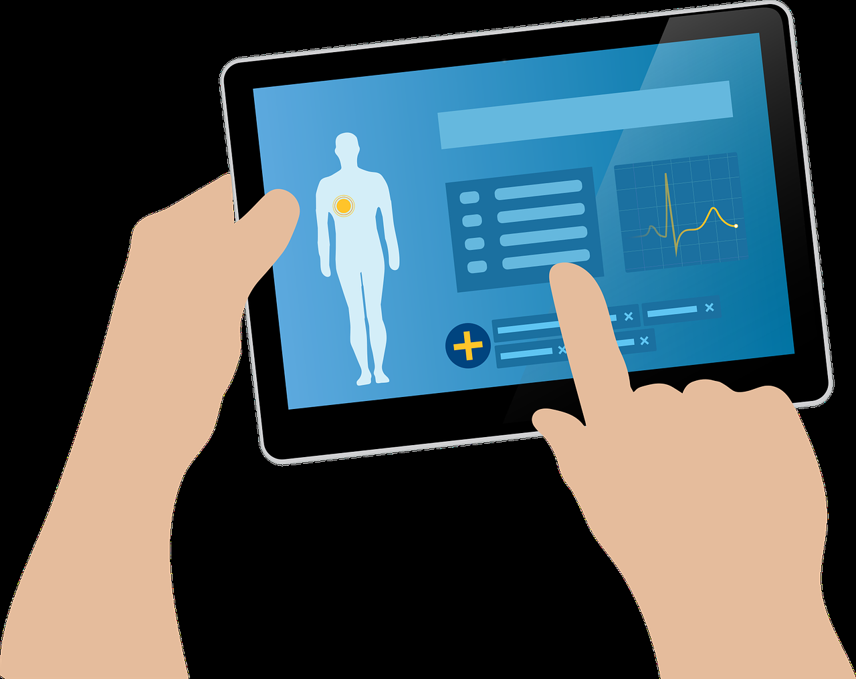
To generate Awareness among the masses
For the user to monitor their health
For the user to know their borderline conditions of their lifestyle
To promote healthy living

Slide 7
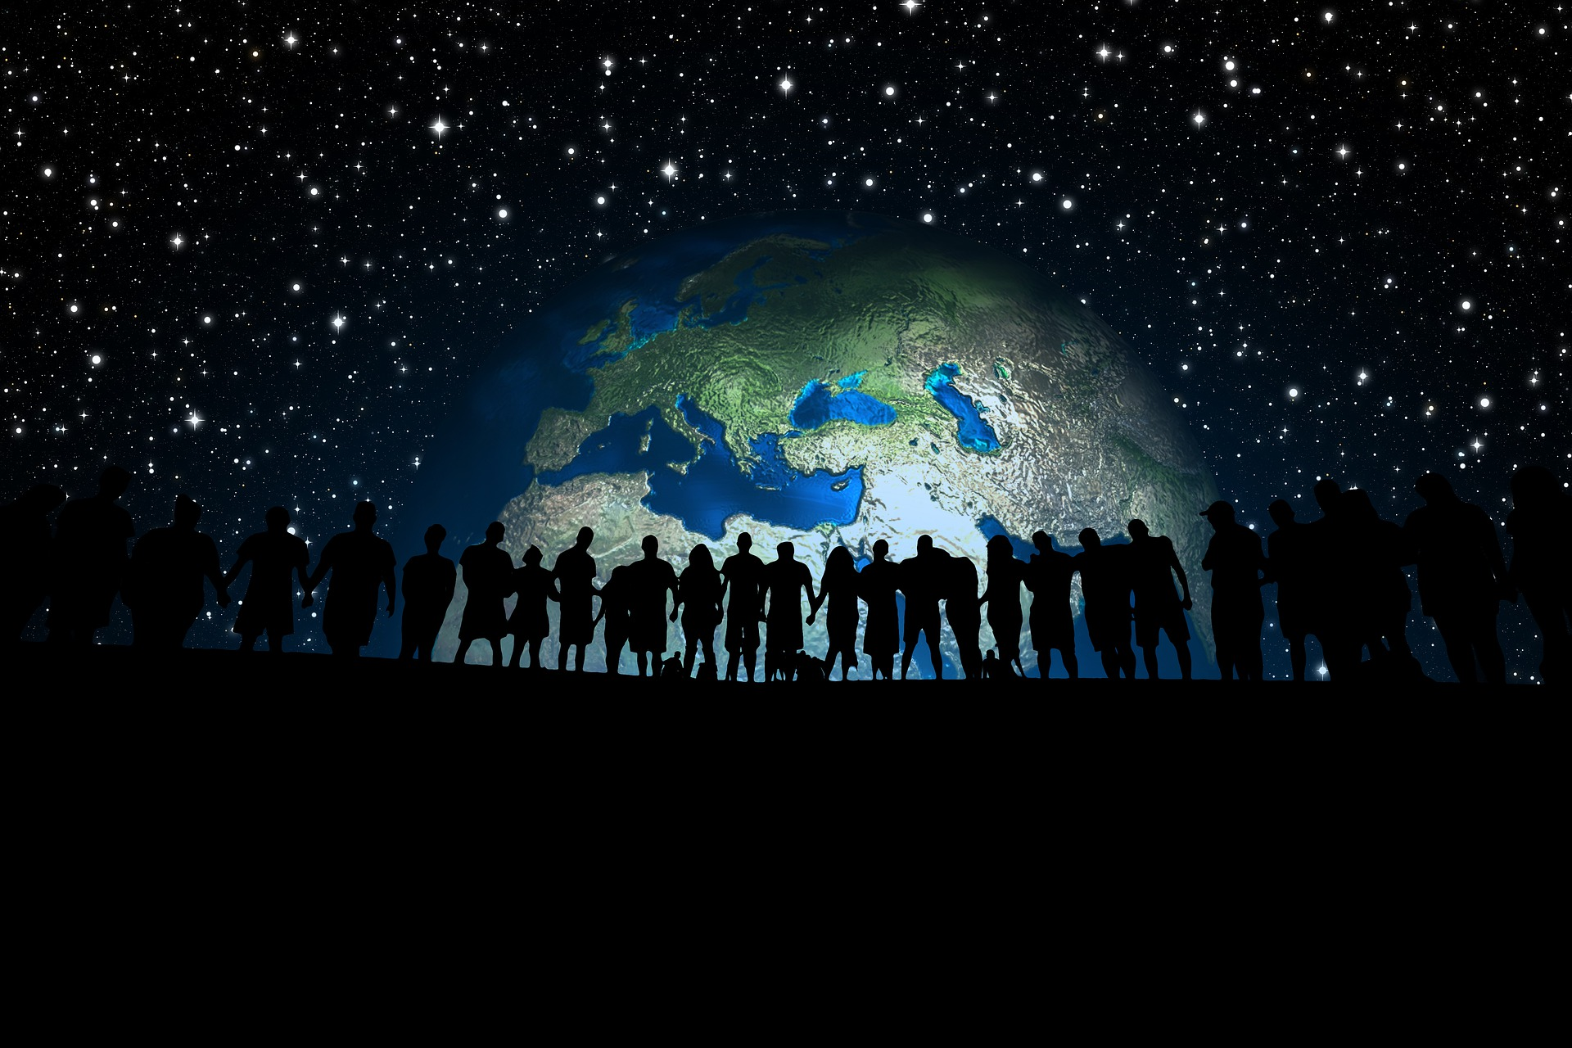


WHO ARE THE END USERS?
General Population
Doctors

Slide 8

YOUR SOLUTION AND ITS VALUE PROPOSITION
Predicting the chronic diseases on simple yet relevant parameters
Predicting Mental Health condition of the end user
Helps the user in monitoring their lifestyle and lead a better , healthier life.

Slide 9


THE WOW IN YOUR SOLUTION
User Friendly Interface
Extensive EDA
Targets for High Recall

Slide 10
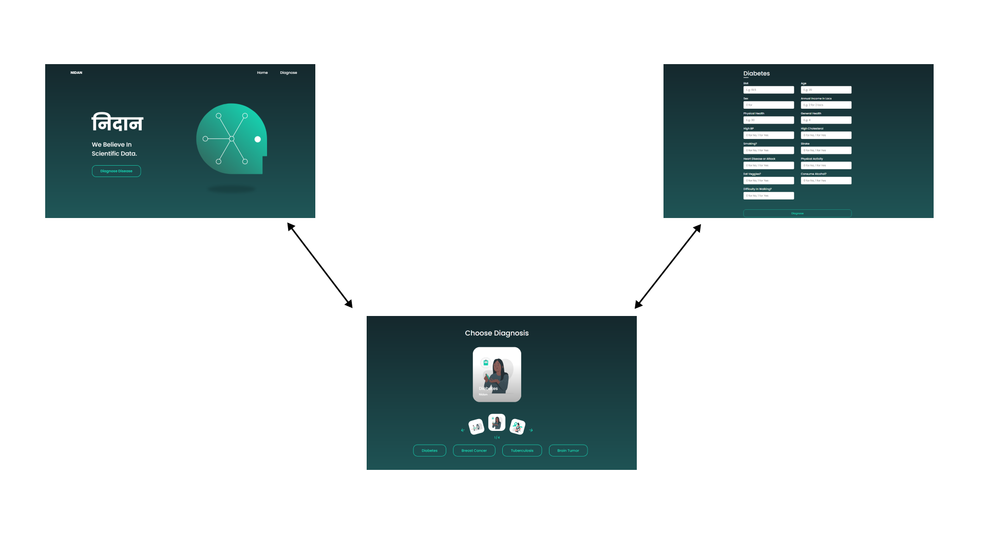
MODELLING
Teams cam add wireframes

Slide 11
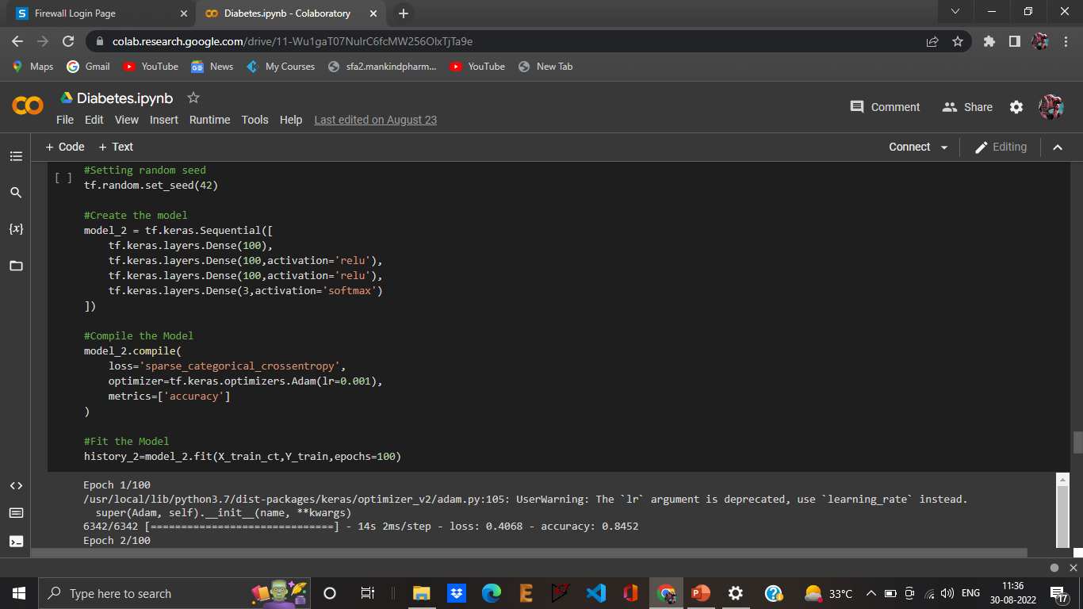
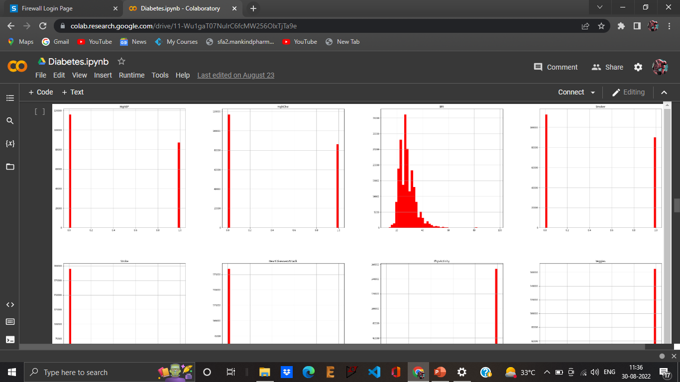
EDA
Model Creation

Slide 12
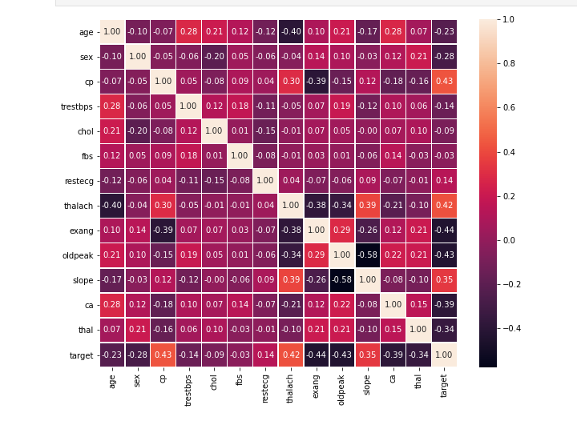
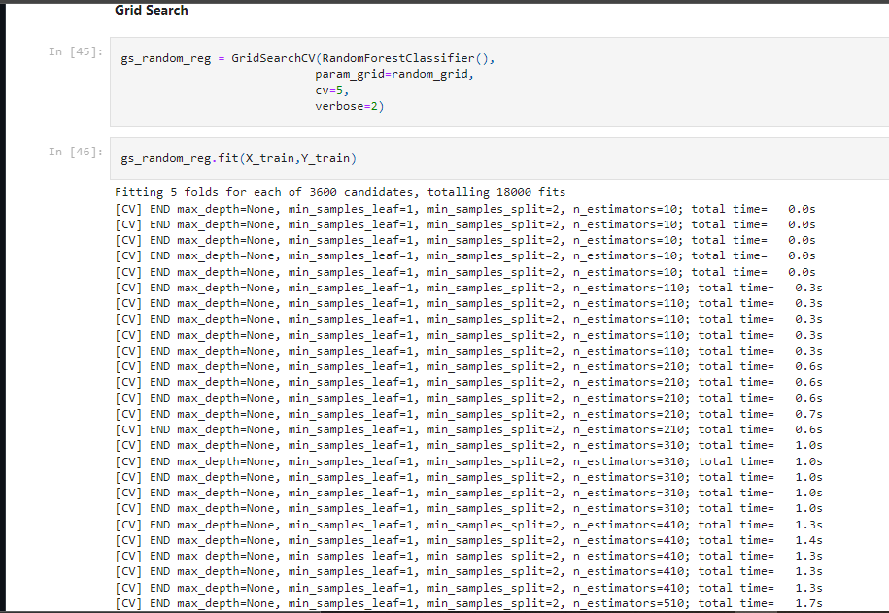
Model Creation
EDA

Slide 13
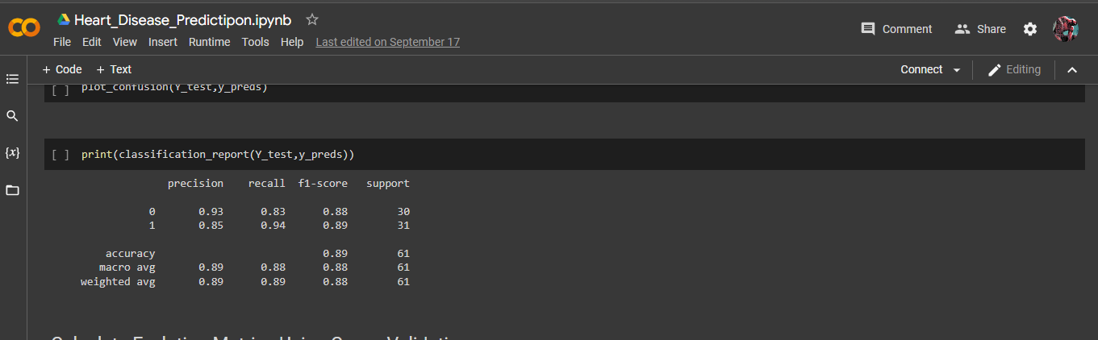
RESULTS
Confusion Matrix and Classification Reports
Heart Disease
https://kuchbhi-kunal.github.io/nidan/

Slide 14
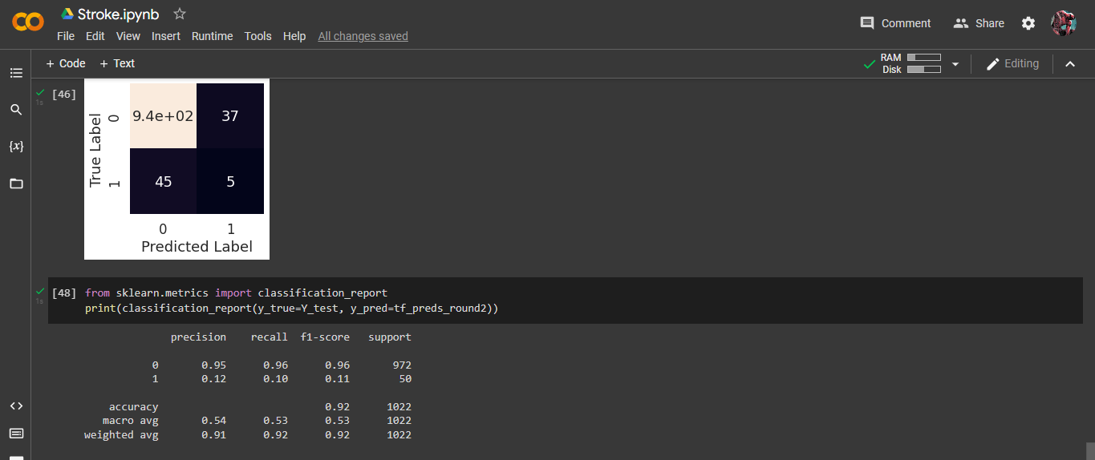
Stroke

Slide 15
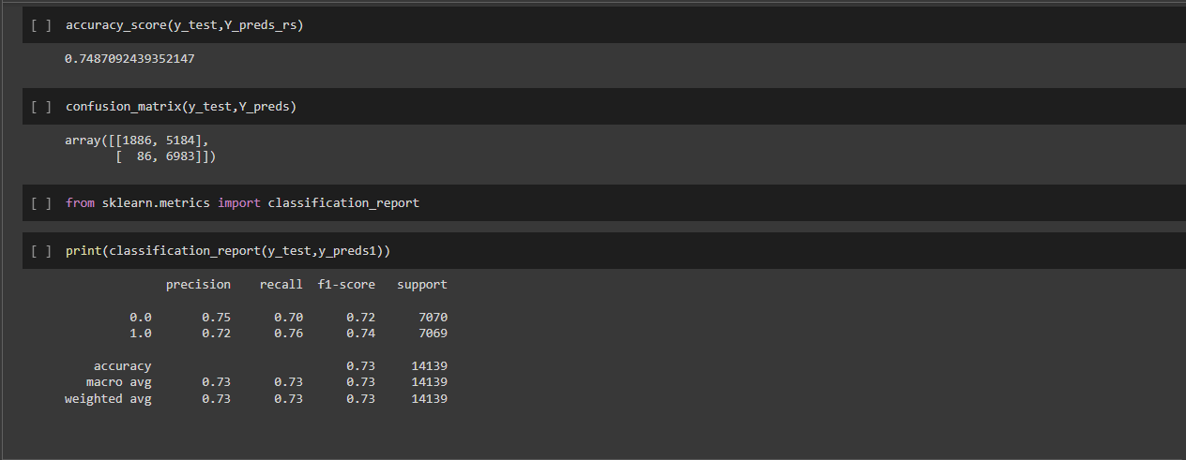
Diabetes

Slide 16
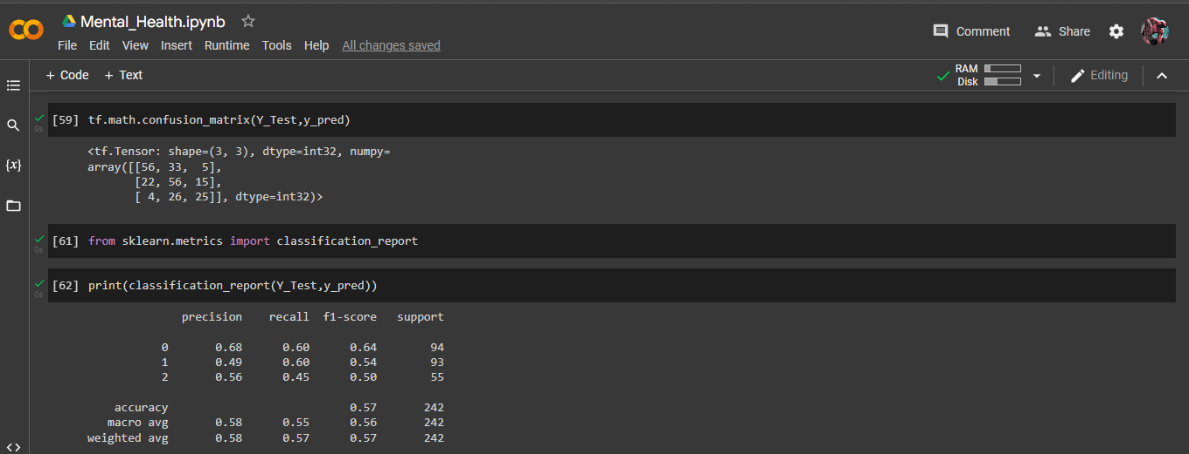
Mental_Health

Slide 17
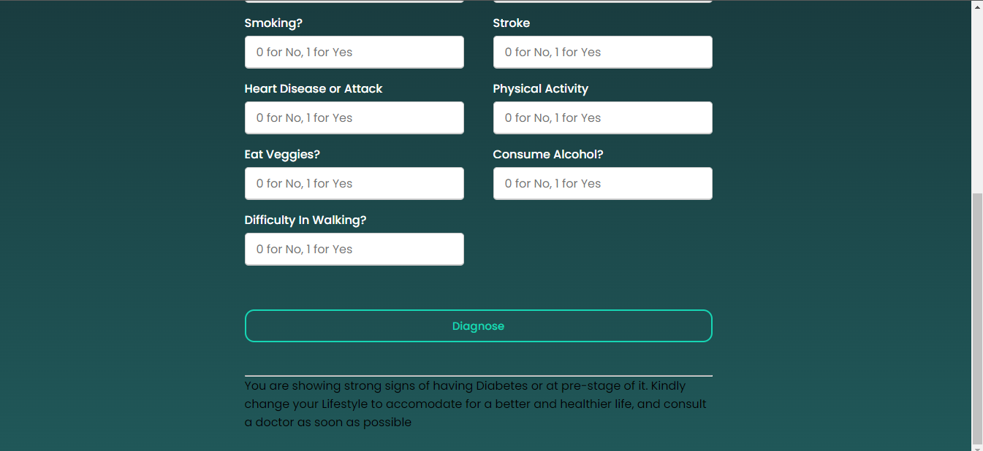
Final Predictions deployed on Front-End

Slide 18
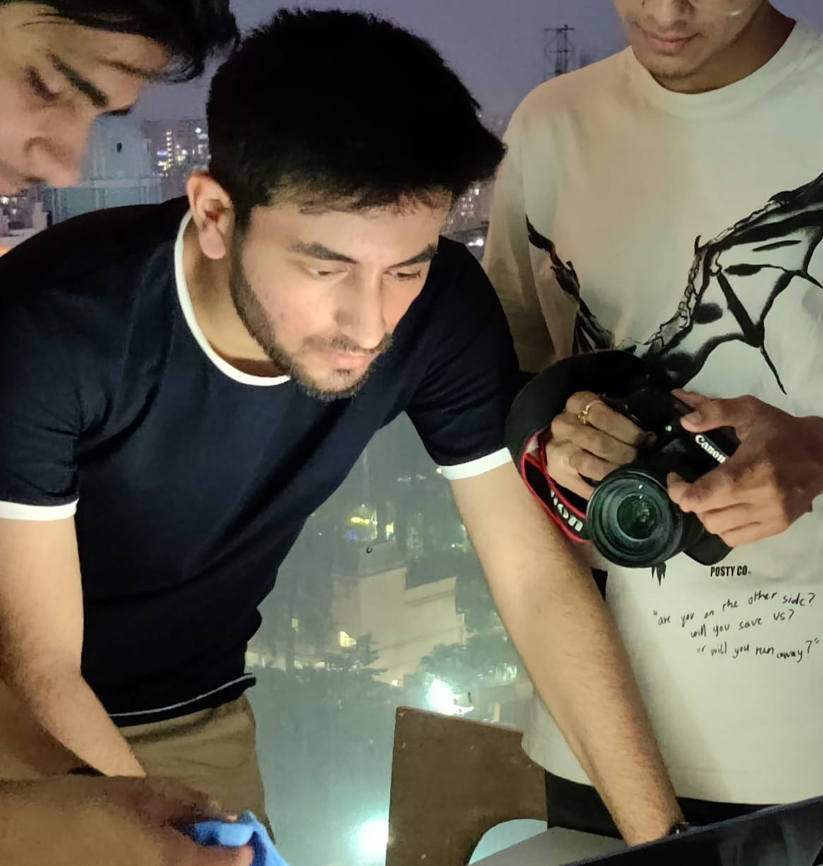

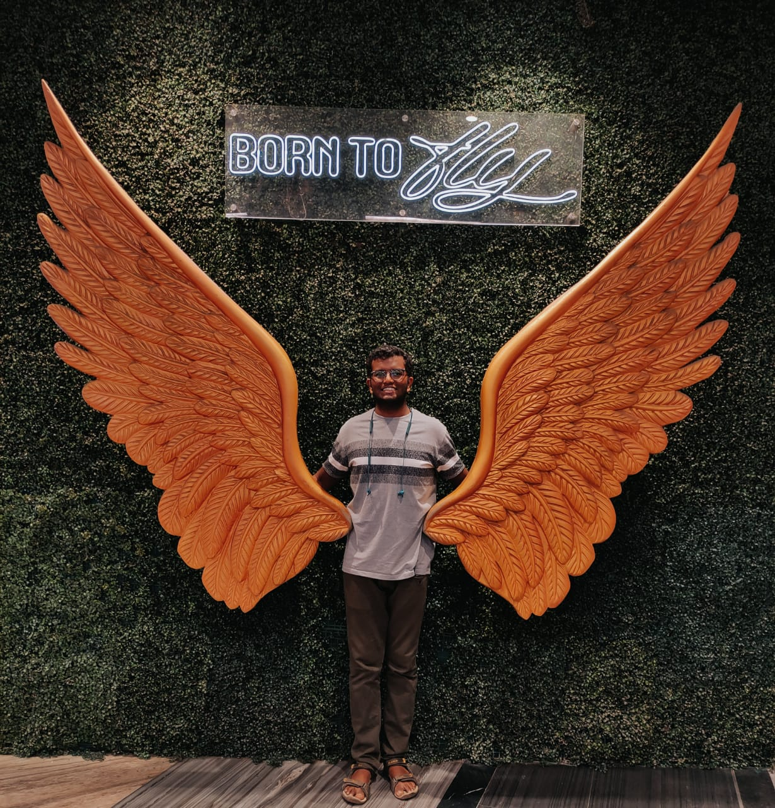
MEET OUR TEAM
Kunal Thakkar
.
.
Pranav Singh
Vedant Tadla

Slide 19

CREDITS
Stakeholders VOIS | Subject Matter Experts(SMEs) Mayank Srivastava | Coaches VOIS

